Slide 1
Digital Portfolio
STUDENT NAME: A.Mohammed mydeen
REGISTER NO AND NMID:asunm163u24cs101
DEPARTMENT: BSC COMPUTER SCIENCE
COLLEGE: HINDUSTAN ARTS AND SCIENCE PADUR CHENNAI

Slide 2
PROJECT TITLE
Student digital portfolio

Slide 3


AGENDA
Problem Statement
Project Overview
End Users
Tools and Technologies
Portfolio design and Layout
Features and Functionality
Results and Screenshots
Conclusion
Github Link
3/21/2024 Annual Review

Slide 4

PROBLEM STATEMENT
Many students and professionals struggle to showcase their skills effectively
Traditional resumes lack visual appeal and interactivity.
Recruiters find it hard to evaluate practical skills quickly.
Lack of a centralized platform to display projects, skills, and achievements.
Need for a modern, digital portfolio solution to stand out.

Slide 5

PROJECT OVERVIEW
1.Development of a personal digital portfolio system.
2. Aims to highlight skills, projects, and achievements in a professional way.
3. Provides an easy-to-navigate platform for end users.
4. Built using modern web technologies for better performance.
5. Focused on being responsive, engaging, and user-friendly.

Slide 6
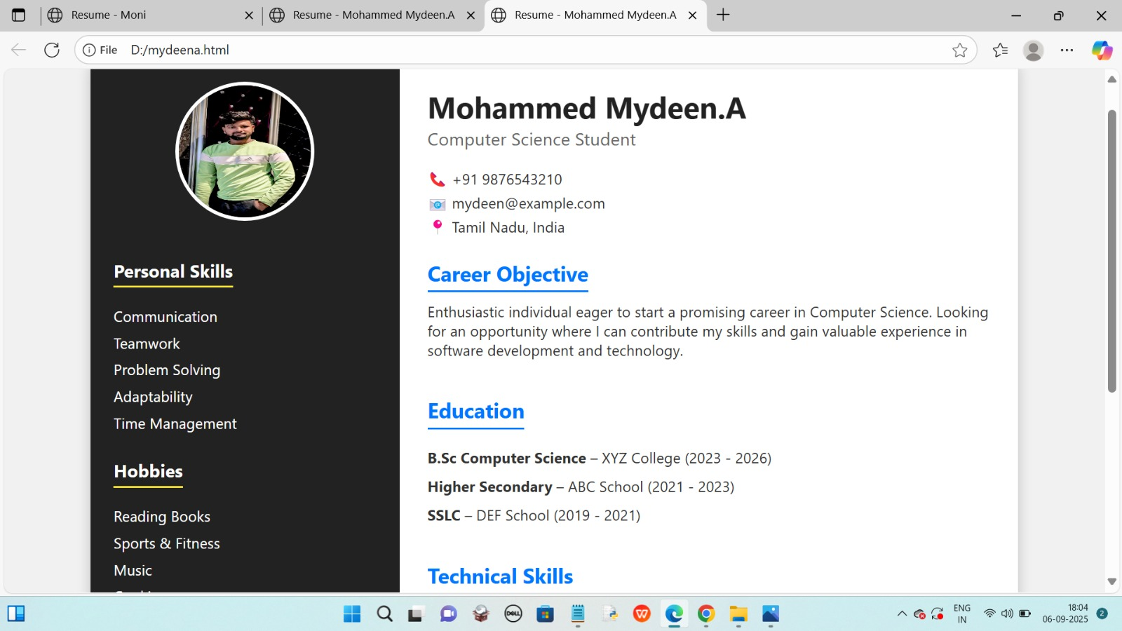
Screenshot

Slide 7

WHO ARE THE END USERS?
1. Students showcasing academic projects.
2.Job seekers presenting professional skills.
3. Recruiters and HR professionals reviewing candidates.
4. Freelancers displaying their portfolios for clients.
5. Educators or institutions highlighting their work.

Slide 8

TOOLS AND TECHNIQUES
Frontend: HTML, CSS, JavaScript (or React/Angular)
Backend: Node .js , PHP, or Python.
Database: MySQL / MongoDB.
Design: Figma , Canva for UI/UX layouts.
Development tools: GitHub, VS Code for version control & coding.

Slide 9
PORTFOLIO DESIGN AND LAYOUT
1. Home page with a professional introduction.
2. Sections: About Me, Skills, Projects, Resume, Contact.
3. Consistent color scheme and typography.
4. Mobile-friendly responsive layout.
5. Smooth navigation with menus and quick links.
9

Slide 10
FEATURES AND FUNCTIONALITY
1.Interactive project showcase with images and descriptions.
2. Downloadable resume/CV option.
3. Contact form with email integration.
4. Search/filter feature for projects
5. Social media and LinkedIn/GitHub integration.

Slide 11

RESULTS AND SCREENSHOTS
Fully functional portfolio website/app.
Demonstrates technical and design skills.
Improved professional visibility for the user.
Screenshots of working modules/pages included.
Positive feedback from users and recruiters.
3/21/2024 Annual Review
11

Slide 12
CONCLUSION
Project successfully addressed the initial problem
Showcased a professional and modern portfolio solution.
Enhanced technical, design, and presentation skills.
Identified areas for future improvement and scalability.
Demonstrated readiness for professional opportunities.
12

